Slide 1
The Biot-Savart Law
(Text section 30.1, 30.2)
Practice: Chapter 30,
Objective Questions 4, 5, 9
Conceptual Questions 1, 11
Problems 7, 9, 11, 19, 65

Slide 2
Sources of B
B exerts a force on moving charges.
But also, moving charges create magnetic fields.
Two equivalent ways of calculating B produced by currents:
Biot-Savart Law: Field of a “current element”
( analagous to a point charge in electrostatics).
Ampère’s Law: An integral theorem.

Slide 3
Biot and Savart: each “current element” I ds (a very short length ds of wire, carrying current I) produces a field dB throughout space:
dB
Ids
In reality, the current element is part of a complete circuit, and only the total field due to the entire circuit can be observed.

Slide 4

Biot-Savart Law
Field produced at a vector distance r by a “current element” I ds :
^{dB}(out of page)
r
dB ⊥ current
dB ⊥ r
r
θ
1
dB ∝
dB
_{r} 2
I
I
ds
∝ sin θ

Slide 5
dB
r
Ids × rˆ
_{r} 2
dB = ^{μo}
r
ds
4π
I
θ
I
μ = 4π × 10 ⁻ ⁷
T ⋅ m/A
o
(“permeability of vacuum”)
We get the total B by integrating along the wire:
_{B =} μ _{o} I ds × rˆ
_{r} 2
∫
4π

Slide 6
Example:
Find B at a distance R from a long straight wire y
dB
ds = dx ⋅ ^{ˆ}i
θ
R
φ
r
I
x
dx
_{dB =} μ _{o} I sin θ _{dx}
_{r} 2
(in z - direction)
4π
(note sin θ = R/r = cos φ)

Slide 7
Quiz
The magnitude of the field will be
y
dB
ds = dx ⋅ ^{ˆ}i
θ
R
φ
r
I
x
μ I
dx
∫
∞
dx
A) B =
0
4π
−∞ _{R}
2
x
2
∫
∞
Rdx
B) B = ^{μ0 I}
2 _{+ x}2 ₎3/ 2
xdx
4π (R
−∞
_{C) B =} μ₀ I
∞
∫
2 _{+ x}2 ₎3/ 2
4π (R
−∞
D) None of the above

Slide 8


μ ₀ I
Result: the field produced at a distance R from a long straight wire is
B =
2 π R
The field lines form circles around the wire. Note the right-hand rule.
I
I

Slide 9
Quiz
P
a
I
What is the field at point P?
A) μ₀I/(4πa)
B) μ₀I/(2πa)
C) μ₀I/(πa)
zero
none of the above

Slide 10
Example
Circular loop in y-z plane. Find B.
at the origin
at point (x, 0, 0)
y
I
R
x
(x, 0, 0)
z

Slide 11

At the Origin:
y
dS
R
r
dB
z
I

Slide 12

At the point (x,0,0):
Pick a short segment ds where the wire crosses the y – axis:
I ds
•
dB
θ
R
r
θ
x
θ
r’
θ
dB’
^{x} I ds’

Slide 13
At the point (x,0,0):
Pick a short segment ds where the wire crosses the y – axis:
I ds
₌ μ _{o} I ⋅ ds
•
r
dB
dB
_{r} 2
4π
θ
r
dB = ^{μ o I} ⋅ ^{ds} × cos θ
x
4π
_{r} 2
θ
x
θ
dB’
r’
θ
^{x} I ds’
The total field
(x-component) is B_{x} = ∫
μ I cos θ
o
⋅
ds
4π r
2

Slide 14


Quiz
I
•
dB
r
μ _{o} I ⋅ cos θ _{ds}
θ
B =
∫
r
x
4π
_{r} 2
θ
x
θ
dB’
Which quantities can be treated as constant when doing the integral above?
θ
x
I
I
r
θ
all of the above
two of the above

Slide 15

Field patterns:
I _{B}
current loop
B
bar magnet
S N

Slide 16
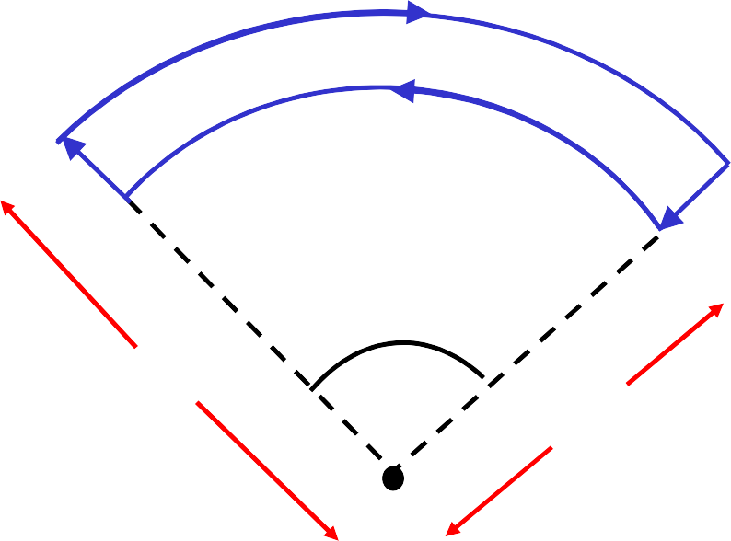
Example Problem
1) For each segment (ab, bc, cd, and da) state whether the field it contributes at point C:
points into the page
points out of the page
is zero.
I
b
I
c
a
d
2) Which field contribution is largest in magnitude?
θ_{o}
R
2
R
1
C
3) Calculate the field at C.

Slide 17
Biot, Savart, and Newton’s Third Law
A paradox?
Find the magnetic force each short current element exerts on the other, using the Biot-Savart picture:
I₁
1 mm
1 mm
I₂
1000 mm

